Slide 1
ITSC 306: Computer Forensics
Module 6: Forensic Analysis – Network Analysis

Slide 2
Module Readings
http://www.ijcaonline.org/journal/number11/pxc387408.pdf
https://docs.splunk.com/Documentation
Getting Started Manual
Search & Reporting Examples
https://www.wireshark.org/docs/wsug_html_chunked/
1.1 What is Wireshark
1.4 A Brief History of Wireshark
2.3 Installing Wireshark Under Windows
3 User Interface
4 Capturing Live Network Data
6 Working with Captured Packets

Slide 3
What is Network Forensics?
Network evidence is comprised of digital evidence created as a result of network communications.
Many appliances or computers are involved in the communication between two computers.
Most of these appliances or computers retain some form of evidence of the communication.
The evidence can include packet captures of network traffic, log analysis, malware call backs, command and control traffic, etc.

Slide 4
Why Network Forensics?
The forensic analysis of a computer hard drive is often the preferred source of evidence but sometimes it is not available.
There is also evidence which may not touch a computer hard drive.
E.g., some malware never touches the hard drive. It remains in memory but may be found in the network traffic.
Some appliances include a sandbox where malware is examined and quarantined before reaching the computer it is headed to.

Slide 5
Sources of Network Evidence
On the wire
In the air
Switches
Routers
DHCP servers
Domain name servers
Authentication servers
Network intrusion detection/prevention systems
Firewalls
Application servers
Central log servers
Proxy servers

Slide 6
Network Forensic Issues
Acquisition may be difficult
Difficult to determine where to place a tap to get the best coverage
Often no accurate network diagrams to work from
Network Address Translation (NAT) may make it difficult to find a system
Time synchronization
Privacy concerns
E.g., a phone wiretap
Limited storage
Not all appliances have sufficient memory to store data for more than a limited time
Volatile storage will be lost if the appliance loses power
Notes:
NAT: Many companies and even home owners use NAT, this means that everyone outside of the local network will see a single IP Address. The firewall for example keeps track of each client in its network and the IP Address associated to it. When the transmission leaves the local network the firewall NAT: will keep track of where it came from and then when the return message comes to the firewalls IP it then sends it to the originating IP Address inside its network
Time Synchronization: Unless Network Time Protocol is being used there is very likely some difference in the time between systems which needs to be taken into account. Also consider the time zone difference if the investigator is working in a different time zone than the system being analyzed was in.
Privacy Concerns: A full packet capture is like a wire tap on a phone line. You get full access to all of the content some of which may have privacy issues. It is possible to collect only the header information which gives the IP Address and port of the sender and receiver as well as the packet size.

Slide 7
Network Forensic Tools
TCP Dump (free – packet capture)
Wireshark (free – packet capture and analysis)
Highlighter (free – log analysis)
Splunk (free/paid – log analysis)
Snort (free – intrusion detection)
Bro (free – network security monitor)
Network miner (free/paid – network forensic analysis tool)

Slide 8
Log File Analysis
Security Information and Event Management (SIEM) software products and services combine Security Information Management (SIM) and Security Event Management (SEM).
They provide real-time analysis of security alerts generated by network hardware and applications.
See: https://en.wikipedia.org/wiki/Security_information_and_event_management
Notes:
There are tools which will let you look at a single log file such as highlighter by Mandiant.
The better option though is to have a SIEM which gathers the logs from a centralized log server.

Slide 9
Splunk
Splunk is an example of a SIEM product
It comes in both a free and paid model
Captures, indexes, and correlates real-time data in a searchable repository from which it can generate graphs, reports, alerts, dashboards and visualizations.
Splunk (n.d.)

Slide 10
Evidence on the Wire
First, try to get a current network diagram
Use it to determine where the ingress and egress points are for the traffic you are trying to capture
Evidence (packets) is gathered using some form of “tap”
Try to put your tap as close as possible to the origin or destination of the traffic you are trying to capture
The network tap has at least three ports:
A Port
B Port
Monitor Port
Notes:
The Network Tapping System is one of the most important network systems. It takes a copy of all the networking events and sends it to the served system to be monitored and analyzed.^{[1]} It is a hardware device which provides a way to access the data flowing across a computer network. In many cases, it is desirable for a third party to monitor the traffic between two points in the network. If the network between points A and B consists of a physical cable, a "network tap" may be the best way to accomplish this monitoring. The network tap has (at least) three ports: an A port, a B port, and a monitor port. A tap inserted between A and B passes all traffic (send and receive data streams) through unimpeded in real time, but also copies that same data to its monitor port, enabling a third party to listen. Network taps are commonly used for network intrusion detection systems, VoIP recording, network probes, RMON probes, packet sniffers, and other monitoring and collection devices and software that require access to a network segment. Taps are used in security applications because they are non-obtrusive, are not detectable on the network (having no physical or logical address), can deal with full-duplex and non-shared networks, and will usually pass through or bypass traffic even if the tap stops working or loses power. Source: https://en.wikipedia.org/wiki/Network_tap

Slide 11
Network Protocols (TCP/IP)
The Internet protocol suite is the conceptual model and set of communications protocols used on the Internet and similar computer networks. It is commonly known as TCP/IP because the original protocols in the suite are the Transmission Control Protocol (TCP) and the Internet Protocol (IP).
The Internet protocol suite provides end-to-end data communication specifying how data should be packetized, addressed, transmitted, routed and received. This functionality is organized into four abstraction layers which are used to sort all related protocols according to the scope of networking involved.
Technical standards specifying the Internet protocol suite and many of its constituent protocols are maintained by the Internet Engineering Task Force (IETF).
The Internet protocol suite model is a simpler model developed prior to the OSI model.
Source: https://en.wikipedia.org/wiki/Internet_protocol_suite
Notes:
Early research
Diagram of the first internetworked connection A Stanford Research Institute Packet Radio Van, used for the first three-way internetworked transmission.
The Internet protocol suite resulted from research and development conducted by the Defense Advanced Research Projects Agency (DARPA) in the late 1960s.^{[3]} After initiating the pioneering ARPANET in 1969, DARPA started work on a number of other data transmission technologies. In 1972, Robert E. Kahn joined the DARPA Information Processing Technology Office, where he worked on both satellite packet networks and ground-based radio packet networks, and recognized the value of being able to communicate across both. In the spring of 1973, Vinton Cerf, the developer of the existing ARPANET Network Control Program (NCP) protocol, joined Kahn to work on open-architecture interconnection models with the goal of designing the next protocol generation for the ARPANET.
By the summer of 1973, Kahn and Cerf had worked out a fundamental reformulation, in which the differences between network protocols were hidden by using a common internetwork protocol, and, instead of the network being responsible for reliability, as in the ARPANET, this function was delegated to the hosts. Cerf credits Hubert Zimmermann and Louis Pouzin, designer of the CYCLADES network, with important influences on this design. The protocol was implemented as the Transmission Control Program (TCP), first published in 1974.^{[4]}
Initially, the TCP managed both datagram transmissions and routing, but as the protocol grew, other researchers recommended a division of functionality into protocol layers. Advocates included Jonathan Postel of the University of Southern California's Information Sciences Institute, who edited the Request for Comments (RFCs), the technical and strategic series that both documented and catalyzed Internet development.^{[5]} Postel stated, “we are screwing up in our design of Internet protocols by violating the principle of layering”.^{[6]} Encapsulation of different mechanisms was intended to create an environment where the upper layers could access only what was needed from the lower layers. A monolithic design would be inflexible and lead to scalability issues. The Transmission Control Program was split into two distinct protocols, the Transmission Control Protocol and the Internet Protocol. The new suite replaced all protocols used previously.,^{[7]} PRnet,^{[8]} and SATnet^{[9][10]}
The design of the network included the recognition that it should provide only the functions of efficiently transmitting and routing traffic between end nodes and that all other intelligence should be located at the edge of the network, in the end nodes. This design is known as the end-to-end principle. Using this design, it became possible to connect almost any network to the ARPANET, irrespective of the local characteristics, thereby solving Kahn's initial problem. One popular expression is that TCP/IP, the eventual product of Cerf and Kahn's work, will run over "two tin cans and a string." (Years later, as a joke, the IP over Avian Carriers formal protocol specification was created and successfully tested.)
A computer called a router is provided with an interface to each network. It forwards packets back and forth between them.^{[11]} Originally a router was called gateway, but the term was changed to avoid confusion with other types of gateways.
Connection Based Protocol
TCP is a connection based protocol which includes a handshake between the sender and receiver. SYN → SYN / ACK → ACK
The protocol insures that all packets are received from the sender.

Slide 12
Network Protocols (UDP)
User Datagram Protocol (UDP) is one of the core members of the Internet protocol suite. With UDP, computer applications can send messages, in this case referred to as datagrams, to other hosts on an Internet Protocol (IP) network. Prior communications are not required in order to set up transmission channels or data paths.
UDP uses a simple connectionless transmission model with a minimum of protocol mechanism.
It has no handshaking dialogues, and thus exposes the user's program to any unreliability of the underlying network: there is no guarantee of delivery, ordering, or duplicate protection.
Source: https://en.wikipedia.org/wiki/User_Datagram_Protocol
Notes:
Used when speed is a necessity and the loss of a couple of packets is not significant.

Slide 13
TCP/UDP Port Numbers
The Internet Assigned Numbers Authority (IANA) is responsible for maintaining the official assignments of port numbers for specific uses.
This does not mean that common services such as a web server can’t use a port other than port 80. The browser just needs to know the IP address and Port Number the server is using for the connection.
System Ports
0 – 1023
Registered Ports
1024 – 49151
System Ports
49152 - 65535
Source: https://en.wikipedia.org/wiki/List_of_TCP_and_UDP_port_numbers

Slide 14
System Ports
Also known as well known ports.
They are used by system processes that provide widely used types of network services.
On Unix like systems a process must have super user account privileges to bind a network socket to an IP Address using a well know port
System ports include:
Port 20 File Transfer Protocol (FTP) – Data Transfer
Port 21 File Transfer Protocol (FTP) – Control
Port 25 Simple Mail Transfer Protocol (SMTP)
Port 80 Hypertext Transfer Protocol (HTTP)
Port 123 Network Time Protocol (NTP)
Port 445 Microsoft SMB – File Sharing & Active Directory, Windows Shares
Source: https://en.wikipedia.org/wiki/List_of_TCP_and_UDP_port_numbers

Slide 15
Registered Ports
They are assigned by IANA for specific service upon application by a requesting entity.
On most systems, registered ports can be used without superuser privileges.
Common Registered Ports include:
Port 1194 OpenVPN
Port 1214 Kazaa
Port 1293 Internet Protocol Security (IPSec)
Port 2195 Apple Push Notification Service
Port 4899 Radmin (Remote Administration Tool)
Source: https://en.wikipedia.org/wiki/List_of_TCP_and_UDP_port_numbers

Slide 16
Ephemeral Ports
Dynamic or private ports that cannot be registered with IANA.
An ephemeral port is a short-lived transport protocol port for Internet Protocol (IP) communications allocated automatically from a predefined range by the IP stack software. An ephemeral port is typically used by the Transmission Control Protocol (TCP), User Datagram Protocol (UDP), or the Stream Control Transmission Protocol (SCTP) as the port assignment for the client end of a client–server communication to a well-known port on a server.
The allocations are temporary and only valid for the duration of the communication session. After completion (or timeout) of the communication session, the ports become available for reuse.
Since the ports are used on a per request basis they are also called dynamic ports.
Source: https://en.wikipedia.org/wiki/Ephemeral_port

Slide 17
Evidence in the Air
Wireless networking sends data from one system to another system through the air
The advantage to a home or business is it avoids having to install cabling to set up the network
In the clear, wireless access points give out their name (SSID), presence, capabilities and will respond to probes.
Even encrypted wireless traffic shows MAC addresses of authenticated systems, unauthorized systems and suspicious systems which may be attacking the network

Slide 18
Switches
Switches are used to connect multiple systems or network segments to a Local Area Network (LAN).
Traffic may traverse multiple switches to get from the originator to the recipient.
Switches contain a content addressable memory (CAM) table.
Stores mappings between physical ports and each network card’s MAC address.
Many switches contain a mirror port that an investigator can connect to in order to capture network traffic.

Slide 19
Routers
Responsible for directing network traffic to its destination
Can make some basic security related decisions
Can lose information if they are reset or powered down
Often necessary to connect via the console or over the network to gather evidence
From a forensic perspective, gathering the evidence via the console is the preferred option
Many of today’s routers have a feature called NetFlow

Slide 20
Cisco Router Commands
Some Cisco ISO commands
show clock detail
Shows time set on device and status of SNTP server
show version
Shows current version of Cisco IOS
show access-list
Shows the access control lists
show logging
Shows logging information on the device
show ip nat translations verbose
Displays the NAT translation table

Slide 21
NetFlow
Provides detailed information on network traffic without capturing network content
Alleviates the privacy concern of full packet capturing
When enabled, NetFlow captures:
Start and end times of each flow
Source and destination IP addresses
Port numbers
Number of packets and bytes in each flow

Slide 22
NetFlow Architecture
Core Components
Exporter
Device with NetFlow collection enabled
Collector
Where the NetFlow messages are sent
Storage
Where the messages are stored and indexed in preparation for analysis
Analysis console
Where the analyst monitors and queries the indexed content of the flows
Identify the choke and critical points in your network to determine where the exporters should be located

Slide 23
DHCP Servers
Used to assign IP addresses to LAN stations
Enables the investigator to determine which system an IP address belongs to on the LAN for a given point of time
The server typically logs the following information:
Assigned IP address
MAC address of the device receiving the IP address
The time the lease was provided or renewed
May include the host name of the device receiving the IP address

Slide 24
Domain Name Servers (DNS)
Enables users to use easier to remember Fully Qualified Domain Names (FQDN) rather than having to remember the IP address of a site
A recursive hierarchical distributed database
Can be configured to log the queries it receives and the hostname returned
Logs can be used to determine where a local user/system has attempted to connect to an external system
Notes:
Root Servers
The authoritative name servers that serve the DNS root zone, commonly known as the “root servers”, are a network of hundreds of servers in many countries around the world. They are configured in the DNS root zone as 13 named authorities, as follows.

Slide 25
Authentication Servers
Large networks have to manage users by having a centralized authentication server
This server needs to log both successful and failed connections
This is a favourite target of attackers
The best way to move around a network is with a valid admin account
Notes:
The authentication server is a favourite target of hackers as they will sit on them and collect passwords as they are entered, including the admin accounts. The hacker can then move around the network as an authenticated user not drawing any attention to themselves.

Slide 26
Network Intrusion Detection/Prevention Systems
Unlike other devices, the Network Intrusion Detection System (NIDS) or Network Intrusion Prevention System (NIPS) is designed to assist the investigator during a security-related incident
They alert the analyst of issues to be investigated
Quality of information received is dependant on the capabilities of the system, its configuration and the placement of its sensors
Notes:
Like all things Garbage in results in garbage out.
You have to ensure that the correct data is being collected and monitored.

Slide 27
Firewalls
Firewalls filter network traffic, restricting access to various systems.
Logging should be set up to send logs to a centralized logging server.
Logging should be set up to log successful as well as failed connections.
Notes:
Log both successful and failed connections. If the attacker has captured someone's login information and is accessing the network when the actual account holder isn’t is significant.

Slide 28
Application Servers
These can include:
Database servers
Web servers
Email servers
VoIP/voicemail servers
Chat servers
Log files from these servers can be very useful during an investigation.
Several of these can be high value targets during a breach investigation.

Slide 29
Centralized Log Servers
Purpose is to have one point of access for all logs generated by the multitude of network devices and systems
If a system is compromised and the logs deleted or altered on the host, the logs may still be available on the central log server.
Devices with minimal storage can send its logs to the central log server where they may be kept for months or years.

Slide 30
Proxy Servers
Web proxies are often deployed with two objectives:
Cache web pages to improve performance and speed up the web surfing experience
Log, inspect and filter web traffic
They can also be used to anonymize traffic
Web site being accessed only sees the IP address of the anonymizing proxy server
Logs useful to determine who has been subject to phishing emails, to identify the source of malware or to identify a user’s inappropriate web surfing

Slide 31
NetworkMiner
A Network Forensic Analysis Tool (NFAT) for Windows (also works in Linux/Mac OS X/FreeBSD)
Can be used as a passive network sniffer/packet capturing tool to detect operating systems, sessions, hostnames or open ports without putting any traffic on the network
Can also parse PCAP files for offline analysis and to regenerate/reassemble transmitted files and certificates from PCAP files
Makes it easy to perform advanced Network Traffic Analysis (NTA) by providing extracted artifacts in an intuitive user interface.
Also saves valuable time for the analyst or forensic investigator.
NetworkMiner (n.d.)
Notes:
NetworkMiner can extract files, emails and certificates transferred over the network by parsing a PCAP file or by sniffing traffic directly from the network.
This functionality can be used to extract and save media files (such as audio or video files) which are streamed across a network from websites such as YouTube. Supported protocols for file extraction are FTP, TFTP, HTTP, SMB, SMB2, SMTP, POP3 and IMAP.
User credentials (usernames and passwords) for supported protocols are extracted by NetworkMiner and displayed under the "Credentials" tab. The credentials tab sometimes also show information that can be used to identify a particular person, such as user accounts for popular online services like Gmail or Facebook.
Another very useful feature is that the user can search sniffed or stored data for keywords. NetworkMiner allows the user to insert arbitrary string or byte-patterns that shall be searched for with the keyword search functionality.
NetworkMiner Professional comes installed on a specially designed USB flash drive. You can run NetworkMiner directly from the USB flash drive since NetworkMiner is a portable application that doesn't require any installation.

Slide 32
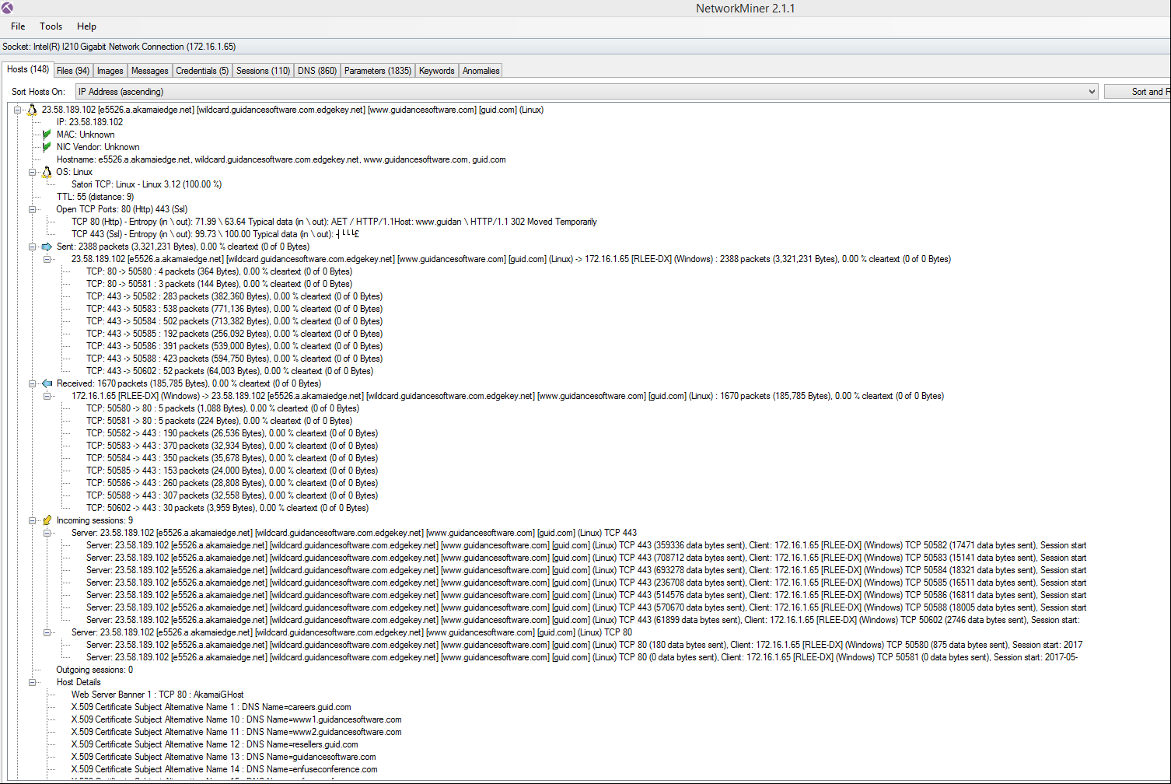
Network Miner

Slide 33
Wireshark
A network packet capture and protocol analyzer
Has a powerful filtering capability, allowing the investigator to focus on the information needed
Possible to extract files from network traffic which could be useful to identify malware or exfiltration of data
Numerous tools and scripts that work with Wireshark can be found at https://wiki.wireshark.org/Tools

Slide 34
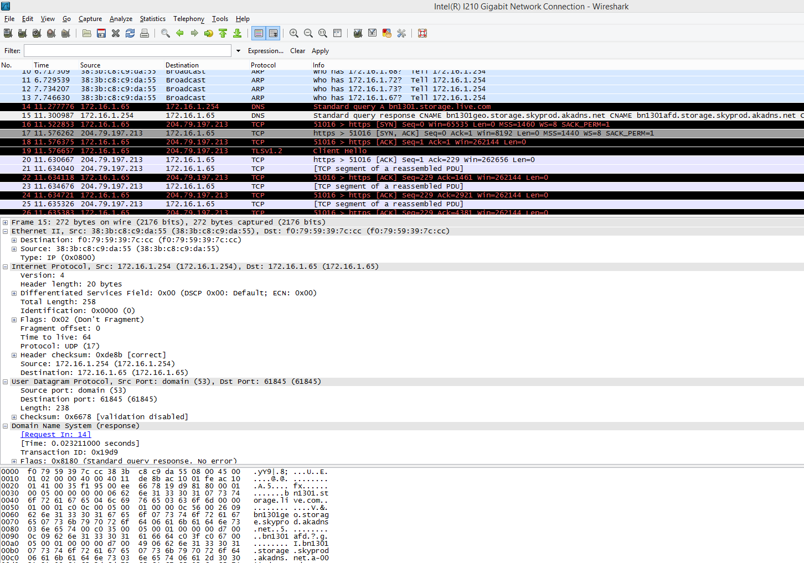
Wireshark
Source: Wireshark. Reproduced and used in accordance with the fair dealing provisions in section 29 of the Canadian Copyright Act for the purposes of education, research or private study. Further distribution may infringe copyright.

Slide 35
Summary
Network forensics is an important item in your digital forensics toolbox because you can’t always find the information to successfully conclude your investigation on the HOST.
There are many sources on the network that collect logs, which can be vital to the successful conclusion of your investigation.
You need to know how to capture and interpret the information traversing the network.

Slide 36
References
Combs, G. (2016). Wireshark [Computer software]. Retrieved from https://www.wireshark.org/
NetworkMiner (n.d.) Retrieved Oct. 18, 2017 from http://www.netresec.com/?page=NetworkMiner
Splunk (n.d.) Retrieved Oct. 18, 2017 from Wikipeida: https://en.wikipedia.org/wiki/Splunk
Wireshark

Slide 37
© 2017, Southern Alberta Institute of Technology. All rights reserved.
This publication and materials herein are protected by applicable intellectual property laws. Unauthorized reproduction and distribution of this publication in whole or part is prohibited.
For more information, contact:
Director, Centre for Instructional Technology and Development
Southern Alberta Institute of Technology
1301 16 Ave. N.W., Calgary, AB T2M 0L4

